Slide 1
Activity: Wireframing
SE for Startups
Heather Miller

Slide 2
Activity: Wireframing & basic identity for snow plow app
We will build the next class around the ideas that you propose.

Slide 3
Wireframes?
A low-risk way to explore your user interface and user experience.
Usually done in two steps:
Several iterations of hand-drawn wireframes with notes/ideas of behaviors sketched in
digital wireframes

Slide 4
Wireframes

Slide 5
Wireframes

Slide 6
Wireframes

Slide 7
Wireframes

Slide 8
Wireframes

Slide 9
Hand-drawn wireframes:
Start with at least 3.
Quick iterations.
Explore as different of layout ideas as possible. They should not all look similar!

Slide 10
Digital Wireframes

Slide 11
Digital Wireframes

Slide 12
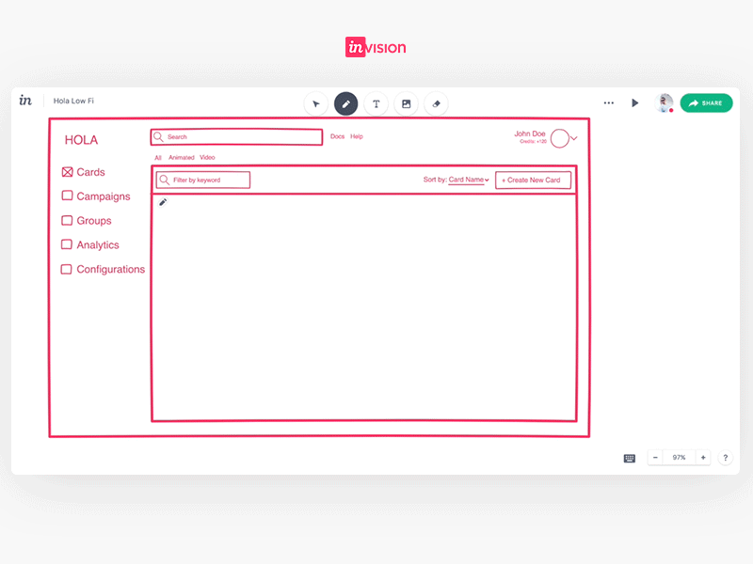
Digital Wireframes

Slide 13
Digital wireframe:
Should be what you want to pitch to your team and/or potentially the customer.
Should be a collection of things you liked from your hand-drawn iterations.
Make it clear and uncluttered!
You can do it online, for free on https://wireframe.cc
Or https://invisionapp.com

Slide 14
Identity?

Slide 15
Lay the groundwork for your company/app’s identity
Propose:
color scheme,
fonts, and
describe an idea for a logo/name.

Slide 16
Lay the groundwork for your company/app’s identity
Propose:
color scheme,
To borrow from interior and fashion design, the 60-30-10 rule states that three colors should be used in varying degrees (60%, 30%, 10%) to create the perfect harmony.
The primary color should cover about 60% of the space and create the overall unifying theme of the design.
The 30% should contrast with the 60% to create a visually striking effect.
The 10% is an ‘accent color’, which should complement either your primary or secondary color.

Slide 17
Deliverables
5 sheets of paper:
3 hand-drawn wireframe iterations
1 printed out digital wireframe: from those 3 hand-drawn wireframe, select elements that you feel are the strongest, and make a wireframe.cc sketch of it
Identity: 1 printed out paper with: (1) a color scheme
(2) 2 font samples (1 for headers, 1 for body text in your pages) (3) logo/name idea/description

